Slide 1
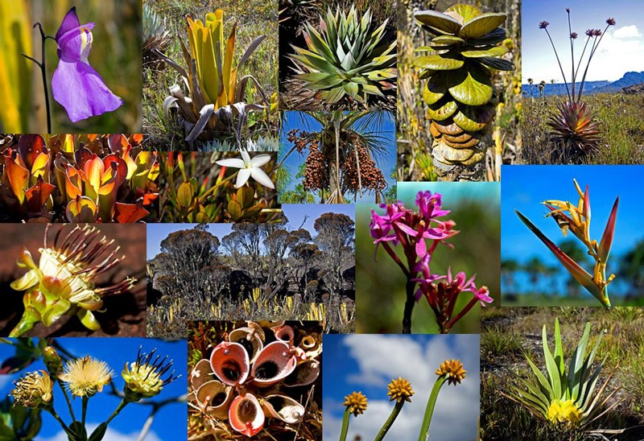
Biodiversity
Biodiversity is genetic variation within populations and variation of populations within ecosystems; the variety of species in one area. The greater the biodiversity within an area, the greater the resources available to support the ecosystems.

Slide 2
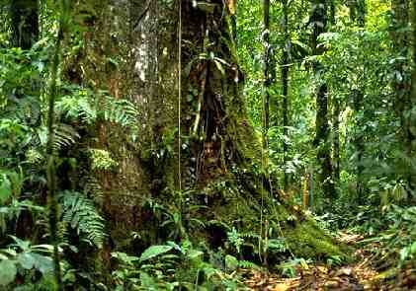
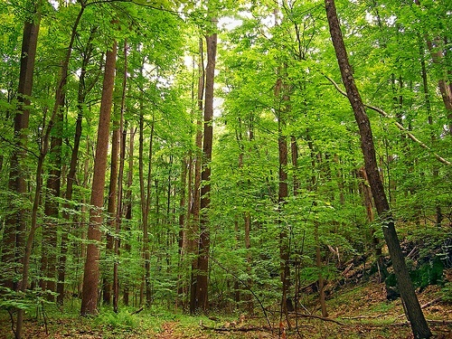
Biodiversity
Simplest measure of biodiversity is the number of different species that live in a certain area
EX: 1 hectare of US contains about 30 different tree species VS 1 hectare of Amazon rainforest that contains 300 species of trees
Which has the greatest biodiversity?

Slide 3
Why is biodiversity important?
All living things are interdependent-any given species depends on the services of another species to survive.
Limits chances of a species extinction-genetic variation in a population prevents one pest or disease from completely wiping out the population.
Variety of organisms help to maintain an ecosystem-organisms collectively can contribute to soil formation, pollution breakdown, nutrient storage, or contribute to climate stability.
Greater biodiversity provides larger pool of resources-more organisms we can use for food, medicinal purposes, wood products, animals for breeding stocks, etc.

Slide 4
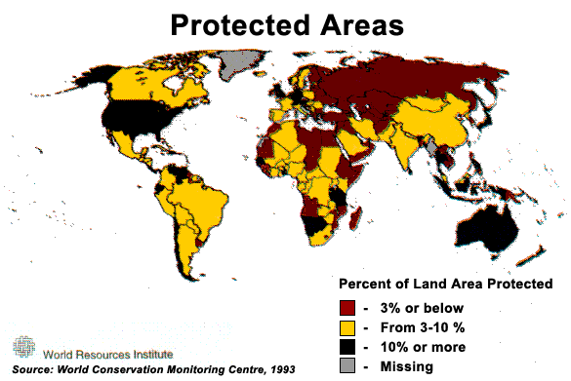
Threats to Biodiversity
Human population growth
Invasive species
Habitat alteration
Pollution – air, water, trash, etc
Overharvesting
Poaching
Exotic Species Trade

Slide 5
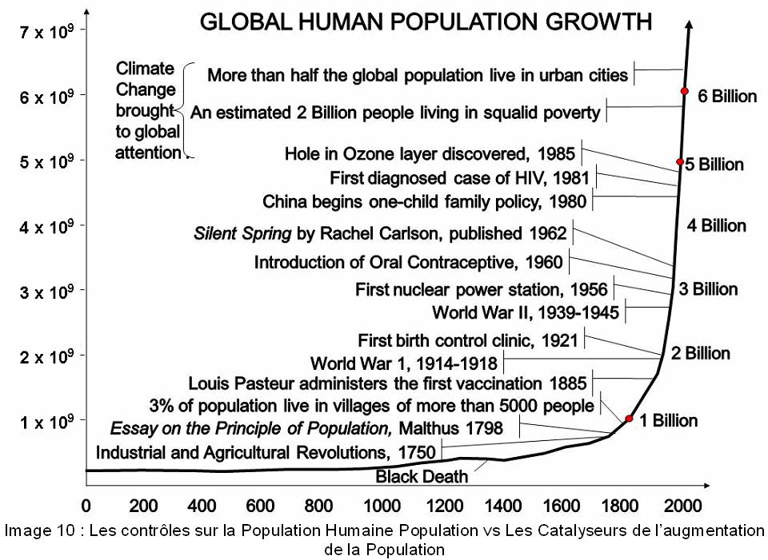
Human Population Growth
Current birth rate is higher than death rate, so Earth’s population is steadfastly increasing.
Demand for resources is increasing. However, the amount of resources is not increasing.
At some point, Earth’s population may go beyond its carrying capacity and there will not be enough resources to supply the needs of the population.

Slide 6
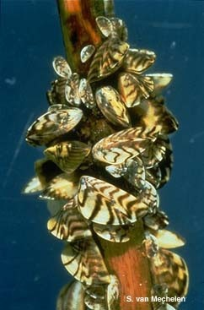
Invasive Species
A nonnative species whose introduction causes economic, environmental, human health issues by disrupting ecosystem.
Take resources from native species.

Slide 7
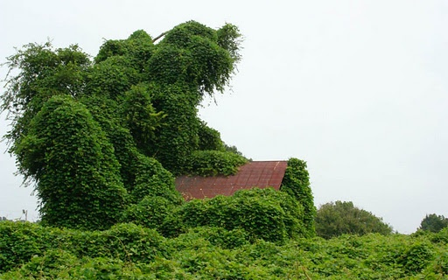
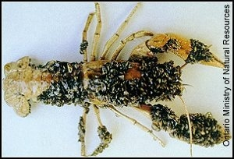
Invasive Species
Kudzu introduced intentionally to US as an ornamental plant and to help reduce soil erosion. However, it grows rapidly, smothering areas of native plants.
Zebra mussels were introduced unintentionally to Great Lakes from ballasts of ships. These fast growing mussels clear the water, but block many food chains.

Slide 8
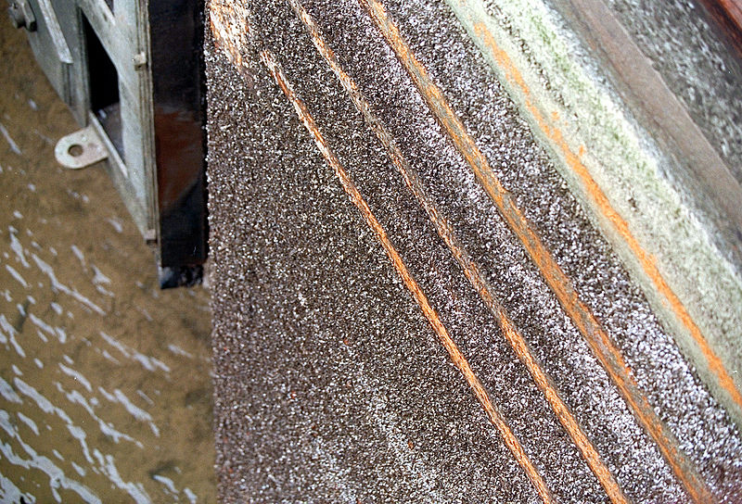

Slide 9
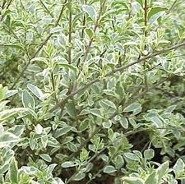
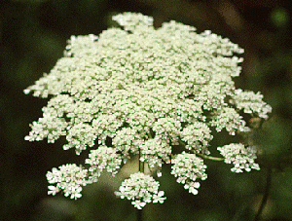
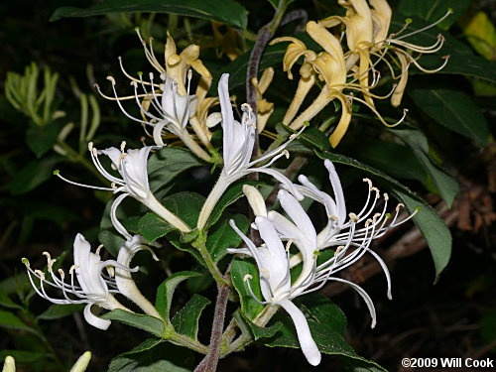
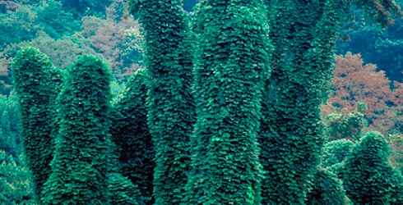
Invasive Species Present in NC
Kudzu, Japanese Honeysuckle, Queen Anne’s Lace, Chinese Privet

Slide 10
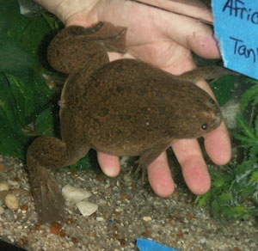
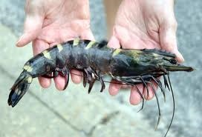
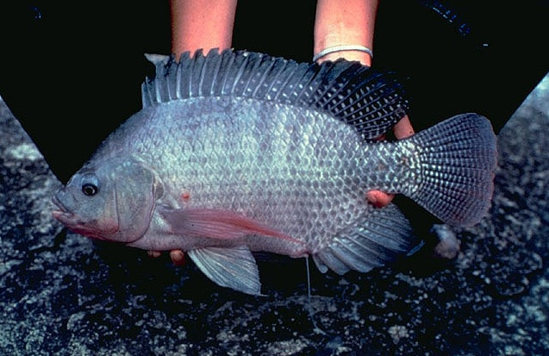
Invasive Species Present in NC
African Clawed Frog
Asian Shore Crab
Asian Tiger Shrimp
Rock bass
Blueback herring
Blue tilapia
Nile tilapia

Slide 11
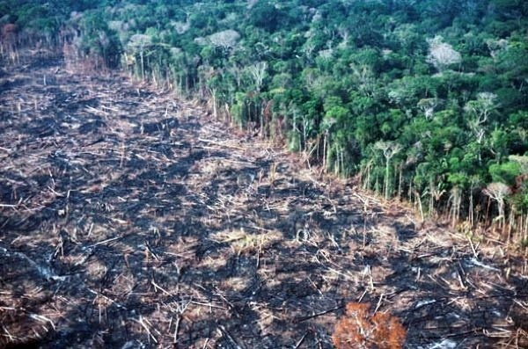
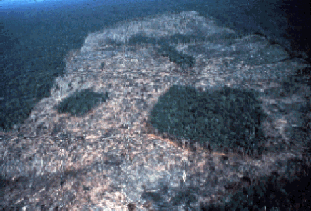
Habitat Alteration
Any change that occurs to an existing habitat.
Ex:
Clear cutting-removing all plants, destroying habitats
Selective cutting-removing only parts of a region, causing, habitat fragmentation, separating species from one another, increasing or decreasing populations as a result.

Slide 12
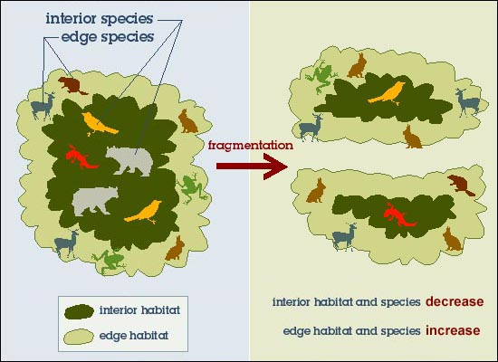
Habitat Fragmentation
Larger species in greater danger; large predators may not find enough food if restricted to too small an area.

Slide 13
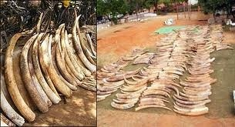
Over Harvesting
Consuming too much of a population severely decrease their numbers, therefore causing a disruption in food chain.

Slide 14
Pollution – Habitat Degradation
Habitat degradation is the damage done to a habitat by pollution – air, land, or water.
Examples of causes are acid rain, eutrophication and trash.

Slide 15
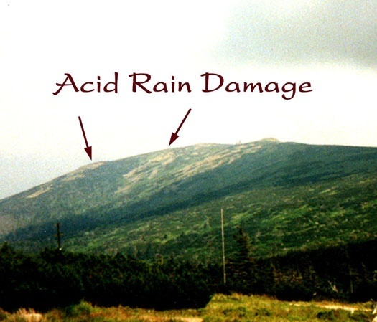
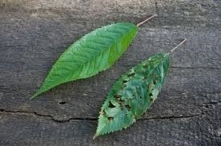
Acid Rain
Acid rain is any precipitation that has a low pH value
Water in atmosphere becomes acidified due to: coal burning factories, car exhaust, etc
Results in damage to plant tissue and can affect aquatic species ability to survive

Slide 16
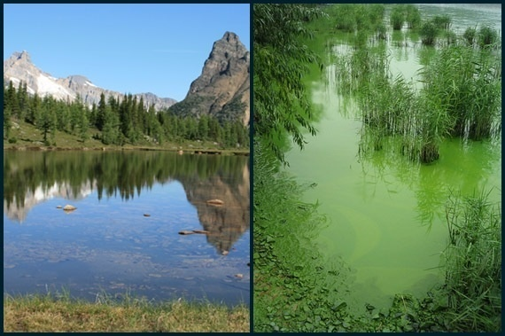
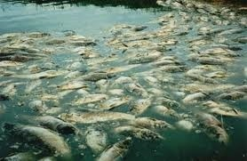
Eutrophication
Fertilizer and animal waste runoff are carried into hydrosphere. These nutrients allow algal blooms to occur. As the algae dies and decays, it removes oxygen from the water, killing the fish and creating dead zones.

Slide 17
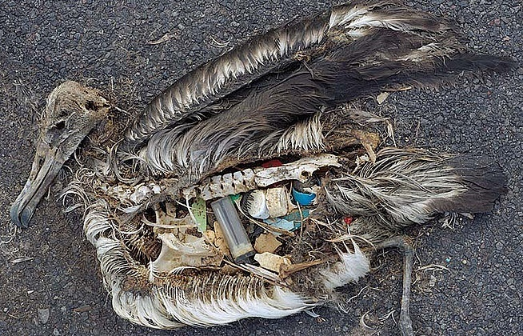
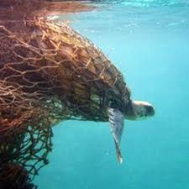
Trash Pollution
Trash and abandoned nets are the cause of death of many aquatic animals.

Slide 18
Consequences of Loss of Biodiversity
Extinction – disappearance of a species; current rate of extinction has accelerated
Ecosystem collapse – if keystone species is removed, the entire ecosystem could collapse (EX: sea otter in kelp forests)
Possible Medicinal cures for diseases – unknown how many or what types of plants could contribute to medicine
Unknown – many ecosystems are so complex that ecologists cannot begin to predict ramifications of biodiversity loss

Slide 19
How to Protect Biodiversity?
Conservation biology – the study and implementation of methods to protect biodiversity
Legislation designed to preserve habitats
Reintroduction and Captive Breeding Programs
Reducing “ecological footprint”

