Slide 1
HYDROSPHERE
Groundwater

Slide 2
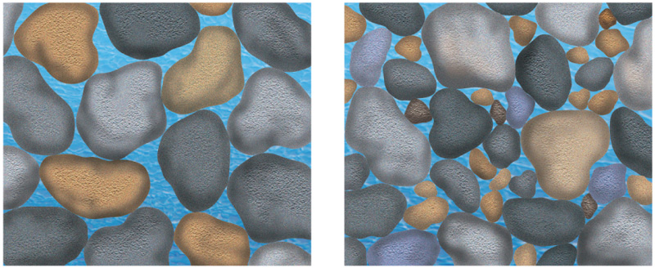
Precipitation & Groundwater
Little precipitation becomes runoff and is returned to the ocean.
The rain infiltrates the ground and becomes groundwater.
Porosity is the percentage of pore space in a material.
Well sorted sediments
High porosity
Poorly sorted sediments
Low porosity

Slide 3
Groundwater Movement
Groundwater moves by twisting and turning through interconnected small openings.
The groundwater moves more slowly when the pore spaces are smaller.
http://techalive.mtu.edu/meec/module01/Infiltration2.html

Slide 4
Groundwater Movement
Groundwater flows downhill in the direction of the slope of the water table.
Permeability is the ability of a material to let water pass through it.
High permeability-large, connected pores Ex sand, gravel
Low permeability-tiny pores, fine grained materials, said to be impermeable Ex silt, clay, shale

Slide 5
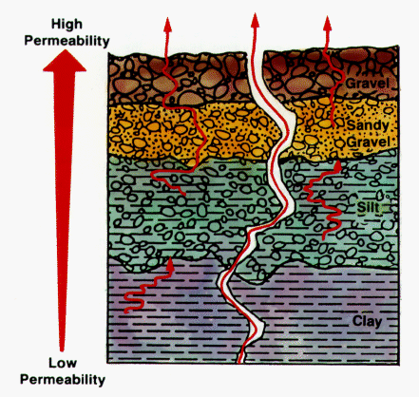
Groundwater Movement

Slide 6
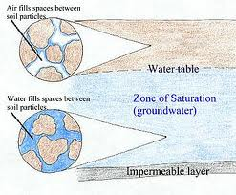
Groundwater
Area above water table is known as zone of aeration, pores filled with air.
The water table is the upper boundary of the zone of saturation.
The zone of saturation is the depth below Earth’s surface at which groundwater completely fills all the pores of a material.

Slide 7
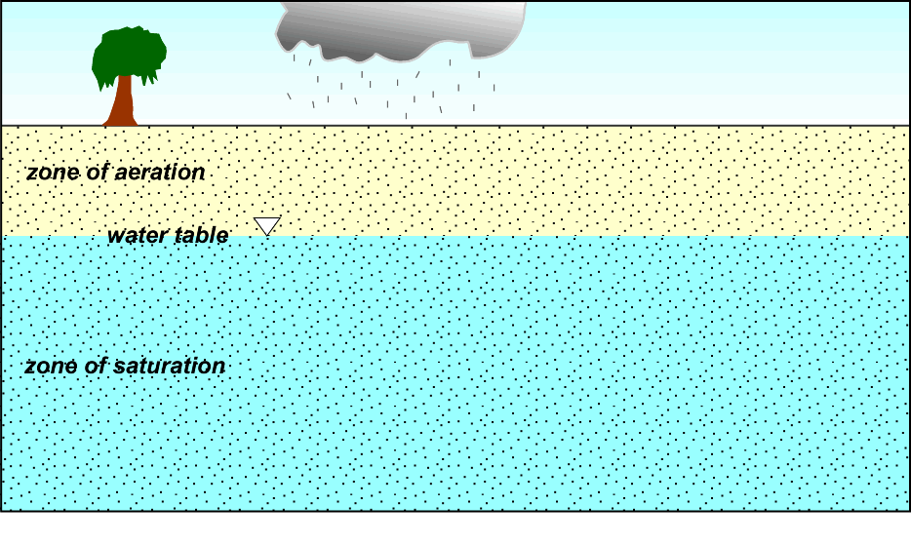
Groundwater
The topography of the water table follows the topography of the land above it.
Because of its dependence on precipitation, the water table fluctuates with seasonal and other weather conditions.

Slide 8
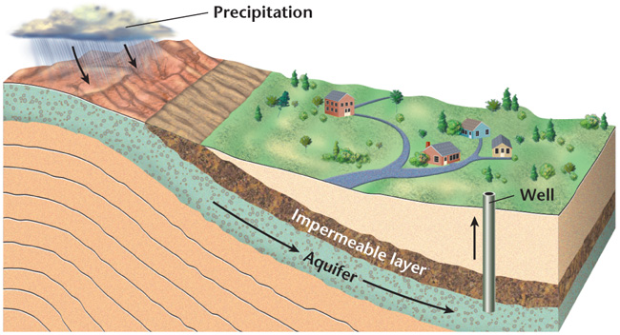
Groundwater
Aquifers are underwater permeable layers where most groundwater flow takes place.
Impermeable layers, called aquicludes, are barriers to groundwater flow.

Slide 9
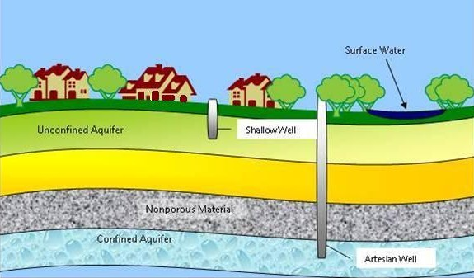
Groundwater
Water-table aquifers are unconfined and unprotected, and thus, easily polluted.
Deeper aquifers, called confined aquifers, are sandwiched between aquicludes.
The aquicludes form barriers that prevent pollutants from reaching such aquifers

Slide 10
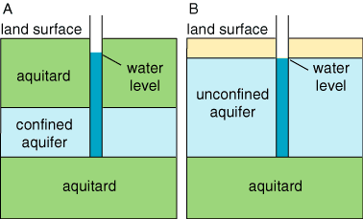
Confined vs Unconfined Aquifers

Slide 11
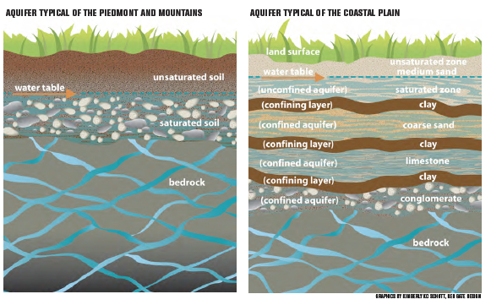
Aquifers of NC

Slide 12
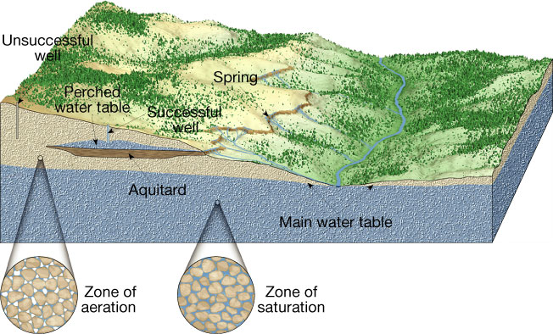
Wells
Wells are holes dug or drilled deep into the ground to reach a reservoir of groundwater.
To produce water, a well must tap into an aquifer

Slide 13
Wells
Drawdown is the difference between the original water-table level and the water level in the pumped well.
Recharge is the process in which water from precipitation and runoff is added back to the zone of saturation
Over-pumping of a well produces a cone of depression around the well.

Slide 14
Wells

Slide 15
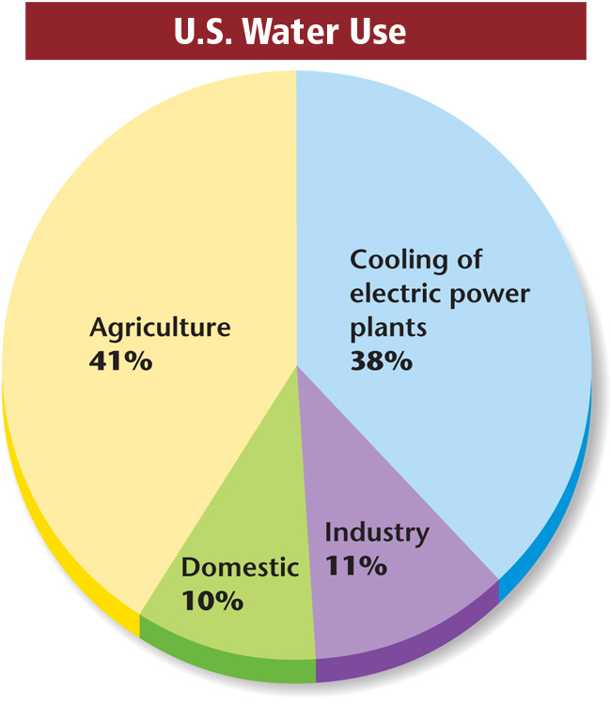
Threats to Our Water Supply
Human demands for freshwater include household use, agriculture, and industry.

Slide 16
Threats to Our Water Supply
Overuse
As human population increases, so does the need for abundant water.
If groundwater is pumped out at a rate greater than the recharge rate, the groundwater supply will inevitably decrease, and the water table will drop.

Slide 17
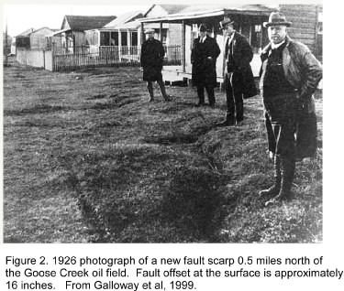
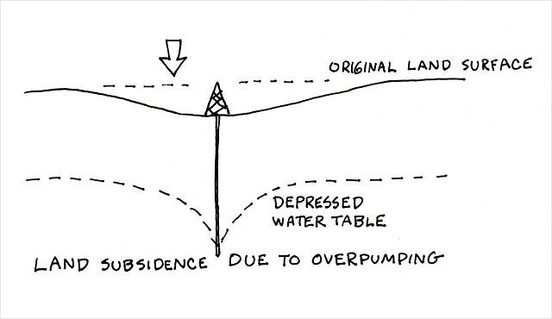
Threats to Our Water Supply
Subsidence
Ground subsidence, or the sinking of land, is a problem caused by the excessive withdrawal of groundwater.

Slide 18
Threats to Our Water Supply
Salt Water Intrusion
The over-pumping of wells near the ocean can cause the underlying salt water to rise into the wells and contaminate the freshwater aquifer.

Slide 19
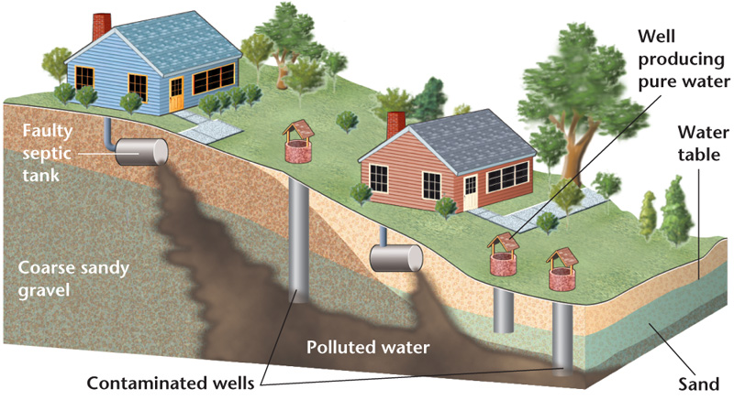
Threats to Our Water Supply
Septic Waste Contamination

Slide 20
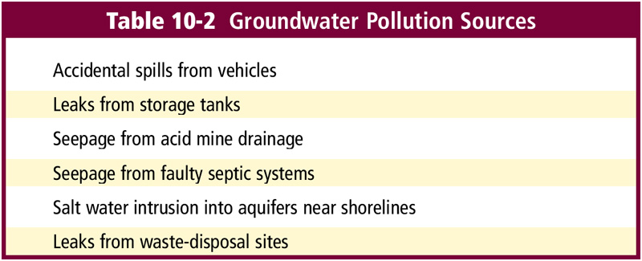
Groundwater Pollution Sources
All major pollution sources need to be identified and eliminated.

Slide 21
Protecting Our Groundwater
Pollution plumes may be stopped by the building of impermeable underground barriers.
Polluted groundwater can be pumped out for chemical treatment on the surface.

