Slide 1
Human Impact
How We Affect the Biosphere

Slide 2
Land Use
How we use the Earth

Slide 3
What types of land use are there?
Deforestation
Urbanization
Agriculture
Land Use
Drilling
Harvesting
Mining

Slide 4
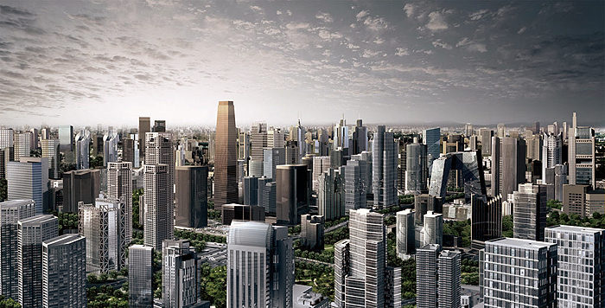
What is Urbanization?
The physical growth of cities, or taking the characteristics of cities

Slide 5
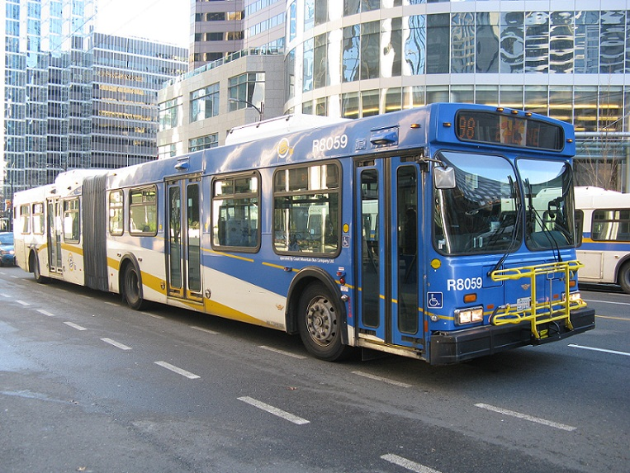
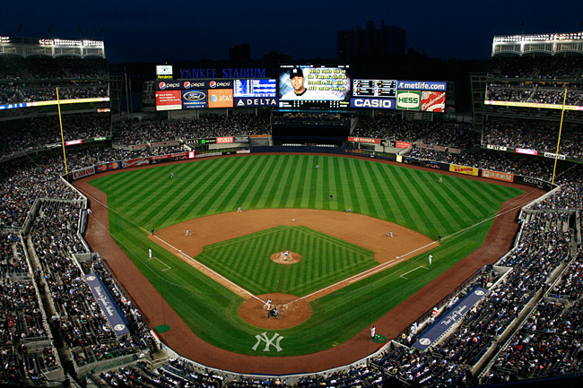
Why do people build cities?
Proximity – so people will be closer to the things they desire
Job opportunities
Transportation and housing
Entertainment and attractions
Diversity
Marketplace competition

Slide 6
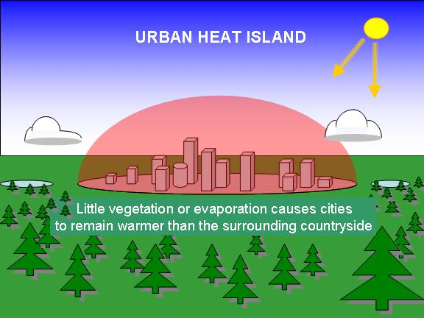
How do cities affect Earth?
Deforestation – cutting down all trees in an area
Increased flooding
impervious (water can’t move through it) surfaces cause water to run off into streams instead of being absorbed
Increased pollution from transportation and factory production
Heat islands – pavement absorbs heat all day and releases it at night making the surrounding area warmer

Slide 7
Causes and Effects of Urbanization
Job opportunities
Increased pollution
Entertainment
Increased flooding
Transportation and housing
Urbanization
Deforestation
Diversity
Heat Islands
Marketplace competition

Slide 8
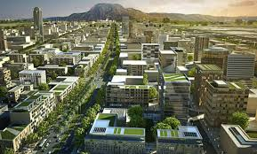
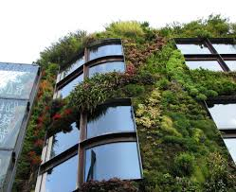
What can we do?
Urbanization
“Green” cities
Add walls that can hold plant life
Walkable urban areas- mixed use so most things are in walking distance of residents
Entice people to move back to cities instead of urban sprawl
Better public transportation
Urban farming
Build structures that use sustainable energies (solar, wind, hydroelectric, etc…)

Slide 9
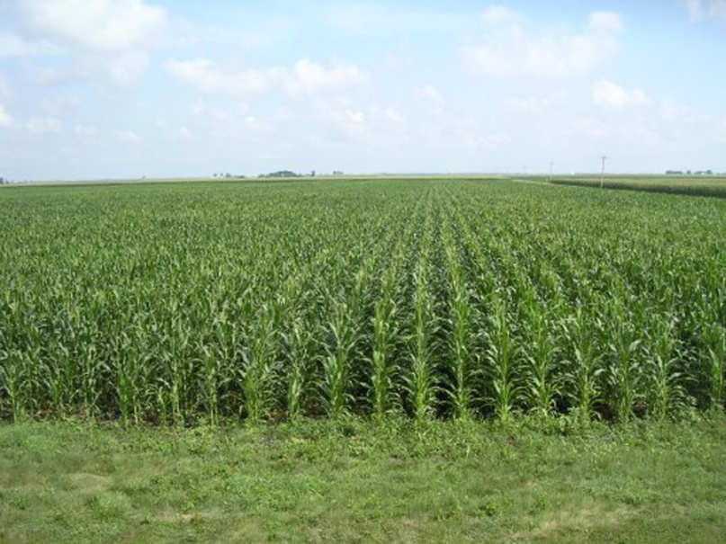
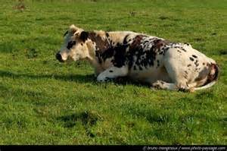
Why is land used for agriculture?
Until humans learned to farm they were nomadic (followed food)
A stable food source
Vegetables
Meats
Animal feed
Economic gain
Non – edible resources – cotton, ethanol

Slide 10
How does agriculture affect the lithosphere?
Soil Erosion
Deforestation
Overgrazing
Desertification
Dryland Salinity
Fresh Water Depletion

Slide 11
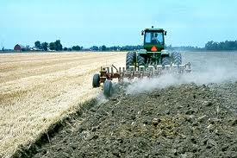
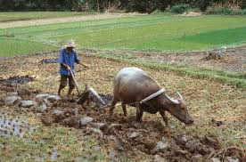
Agriculture
Traditional agriculture techniques, like plowing, remove topsoil and require replanting each year. The United States alone loses almost 3 tons of topsoil per acre per year.

Slide 12
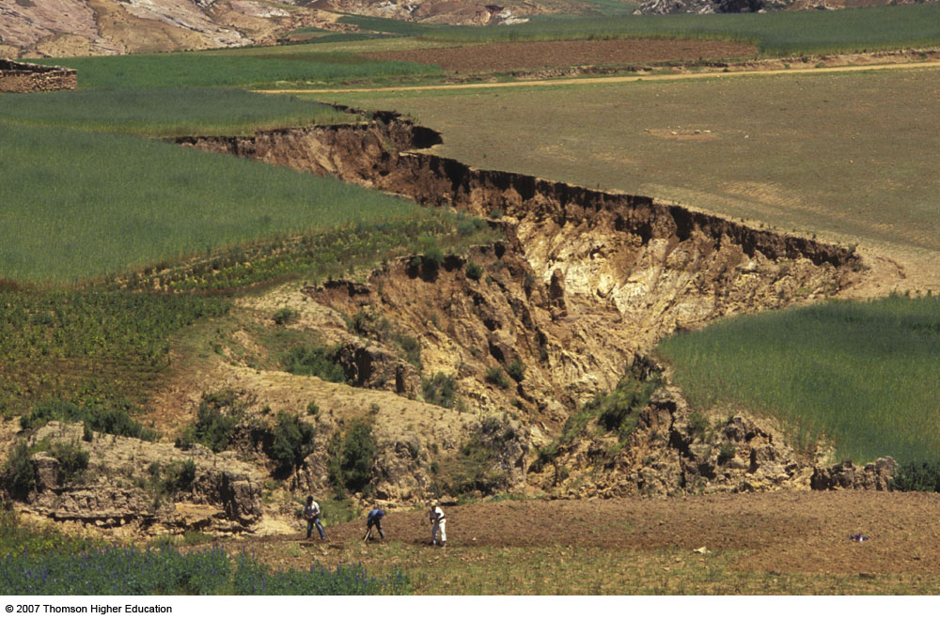
Soil Erosion
Soil erosion is the movement of soil components, especially surface litter and topsoil, by wind or water.
Soil erosion increases through activities such as farming, logging, construction, overgrazing, and off-road vehicles.

Slide 13
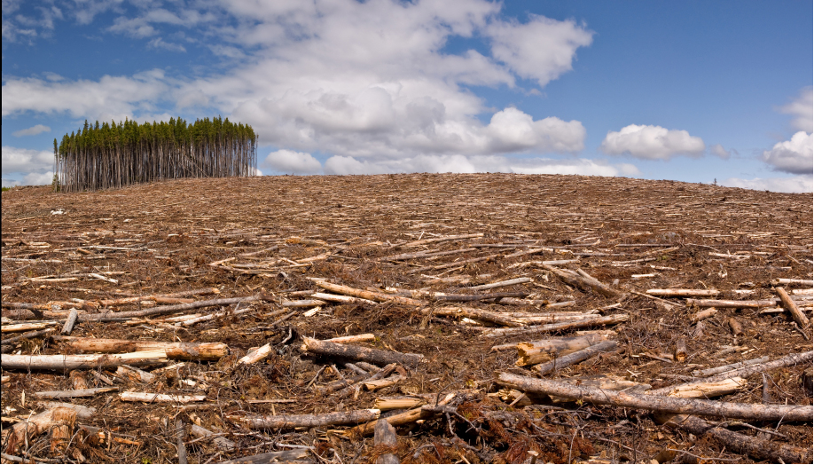
Deforestation
Forests are cut down for the purpose of building and agriculture
Removing plants increases the rate of erosion, because the plant roots no longer secure the soil in one place

Slide 14
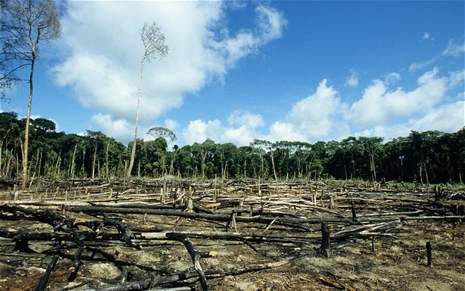
Deforestation

Slide 15
Effects of Deforestation
Deforestation means a loss of habitats, which means a loss in biodiversity
All the different life forms in an area
Increased erosion degrades soil
Increased evaporation leading to drought
Higher CO₂ in the air
Less photosynthesis
How does burning trees contribute to climate change?

Slide 16
What exactly is overgrazing?
Occurs from having more animals on a piece of land than it can support
Plants are exposed to grazing with insufficient recovery period causing roots to grow smaller and eventually plants begin to die off
Soil compaction due to animal trampling can cause the soil to lose its infiltration capacity and increase runoff

Slide 17
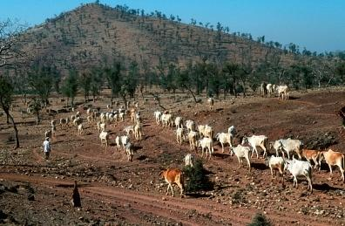
Overgrazing

Slide 18
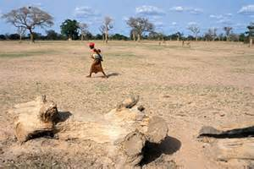
What about desertification?
The process of land becoming a desert, characterized by loss of bodies of water and plant life
Occurs when overgrazing happens in already dry areas
Can be caused by the weight of cattle pressing on the land until it becomes too compacted for plants to grow

Slide 19
What is dryland salinity?
Gradual loss of farmland from rising salt
Salt is located underground but pulled upwards when water tables rise
Domesticated plants have shallower roots
Loss of biodiversity
Huge problem in Australia and other places where underground salt reserves are present

Slide 20
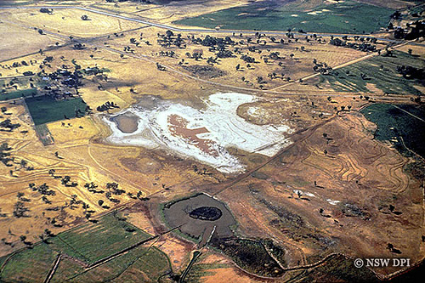
Dryland Salinity

Slide 21
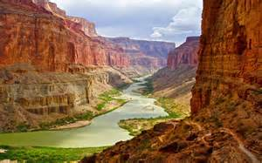
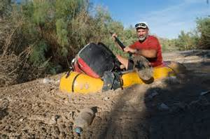
How is freshwater being depleted from agriculture?
Irrigation in arid areas to water crops is pulled from freshwater sources
This has been devastating to the ecosystems of some rivers
Colorado River hasn’t reached the sea since 1998

Slide 22
How is agriculture polluting?
Fertilizers are used to increase crop yield
Pesticides and herbicides to control insects and weeds runoff with rain into rivers
These can cause major problems by contaminating aquifers, ponds, lakes, and rivers
Eutrophication
Hypoxic – dead zones where oxygen levels have decreased to where they cannot support life

Slide 23
What are the causes and effects of agriculture?
Deforestation
Vegetables
Meats
Overgrazing
Feed for livestock
Agriculture
Desertification
Non – edible resources
Dryland salinity
Freshwater depletion
Economic Gain
Soil Erosion
Pollution and dead zones

Slide 24
What can we do?
Agriculture
Keep the proper amount of animals on acreage
Crop rotation to keep soil fertile
Reduces need for deforestation
Purchase seasonally and locally
Drip line irrigation
Reduce the amount of chemicals and synthetic fertilizers

Slide 25
Aquaculture
Farming of fish, crustaceans, aquatic plants, and mollusks
Mariculture – uses sea water to grow aquatic organisms
Integrated methods – often combine various trophic levels of the food chain to make conditions more natural and sustainable

Slide 26
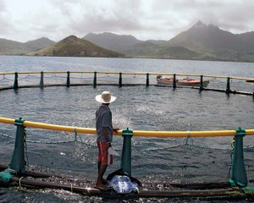
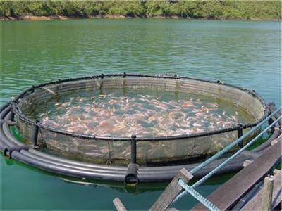
Aquaculture

Slide 27
How is aquaculture affecting the environment?
Can increase water consumption and worsen drought conditions
Some fish are fed pellets, which when not eaten, settle and alter the food chain for benthic organisms (live on the bottom)
Increased fertilizer from feces of fish produces algal blooms
Higher presence of microbial decomposers lowers oxygen levels
What does this cause?
Can introduce new species when pens break

Slide 28
Is aquaculture all bad?
No, aquaculture can decrease the problem of overfishing
Increases the amount of food for consumption

Slide 29
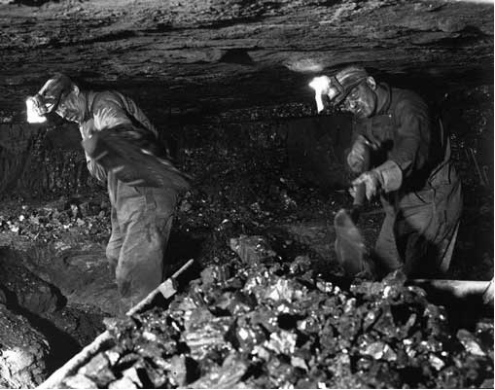
What is mining and why is it done?
Mining is the extraction of valuable minerals or other resources from the earth
Done for
Economic gain
Resources

Slide 30
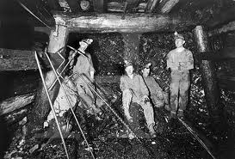
How is mining done?
Surface mining
Sub-surface mining
In-situ mining

Slide 31
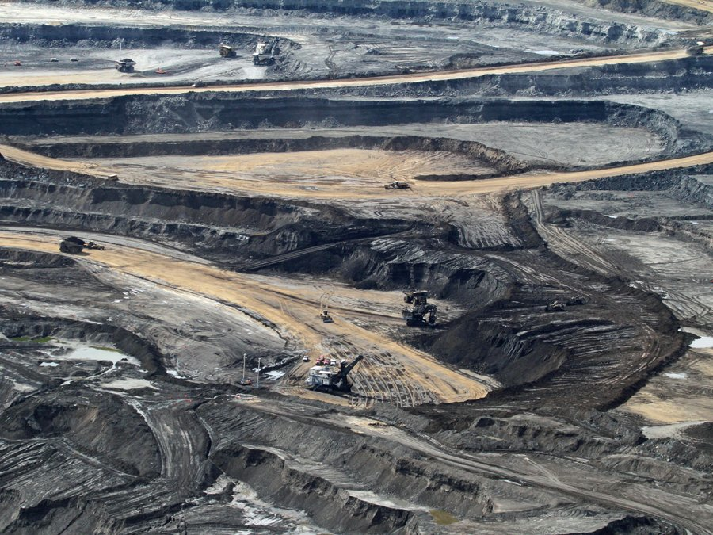
What is surface mining?
Strip mining
Mountain top removal
Open pit mining
Soil and overlaying rock are removed to get to the resource below

Slide 32
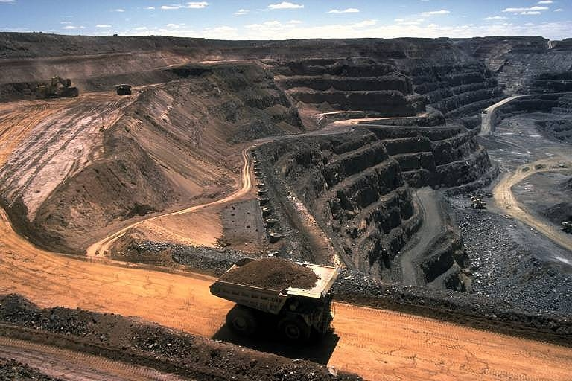
Surface Coal Mining

Slide 33
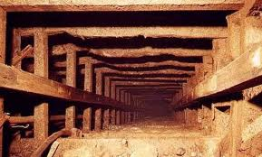
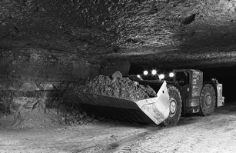
What is sub surface mining?
Digging tunnels or shafts to get to ore deposits

Slide 34
What exactly is coal and how is it extracted?
Coal is either mined underground or in an open pit (through mountain top removal)
Non renewable fossil fuel
Formed in low lying wetlands
Plant matter was buried
Compressed into bituminous coal (soft tar like)
Further compressed into its most usable form, anthracite (hard coal)
What is coal and How is it extracted

Slide 35
How are uranium and plutonium mined?
Uranium mines are:
Open pit
In situ
Underground
Plutonium is extracted from uranium deposits
Radioactive elements used in nuclear energy
Occurs in extremely small amounts in most rocks

Slide 36
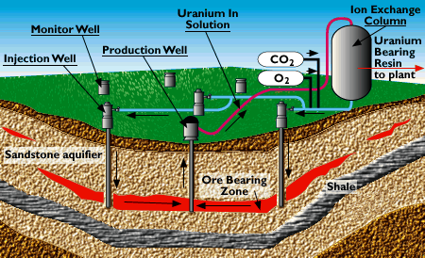
What is in-situ mining?
Commonly done to obtain uranium for energy
Uranium is dissolved into water below the surface
Solution is brought to the surface and the mineral is recovered
In situ mining Video

Slide 37
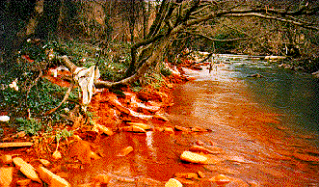
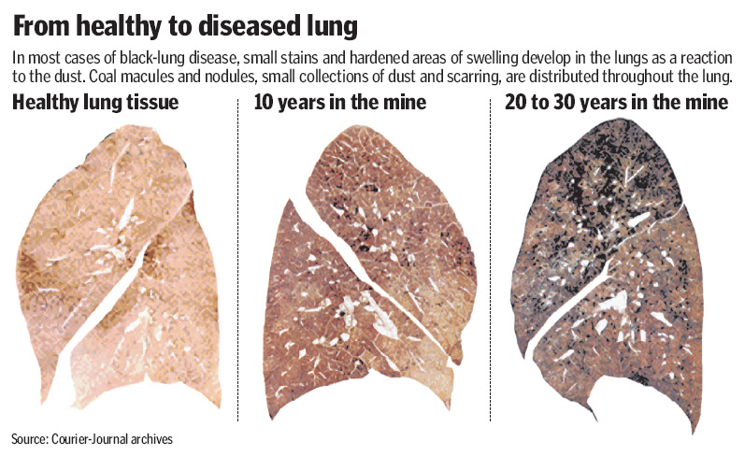
How does mining affect the environment?
Acid mine drainage from sub surface mining
Deforestation
Erosion
Formation of sinkholes
Contamination of soil and groundwater
Some diseases (black lung, blue baby syndrome, asthma)
How does mining affect the environment

Slide 38
Causes and effects of mining
Deforestation
Economic Gain
Acid Mine Drainage
Minerals
Mining
Diseases
Loss of biodiversity
Energy Resources
Contamination of soil and water
Sinkholes

Slide 39
What can we do?
Mining
Alternative energy sources
Write representative to let them know you want more opportunities for these energies
Recycle and reuse goods to reduce need to mine
Reduce consumption of unnecessary items

Slide 40
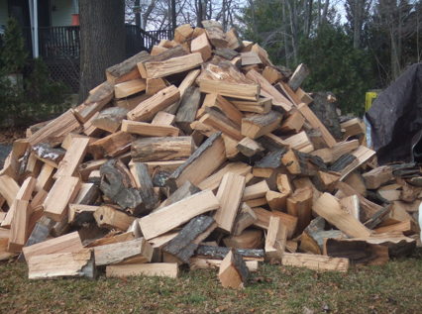
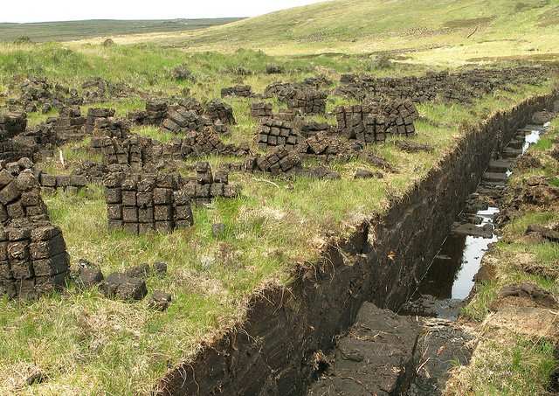
What is harvesting and how is it done?
Gathering of resources from the surface of the Earth
Peat – non – renewable
Wood – renewable

Slide 41
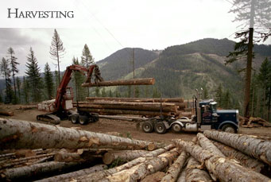
Why is wood harvested?
Renewable energy supply
9% of the world’s energy supply
Used particularly in developing countries
Used for heating and cooking

Slide 42
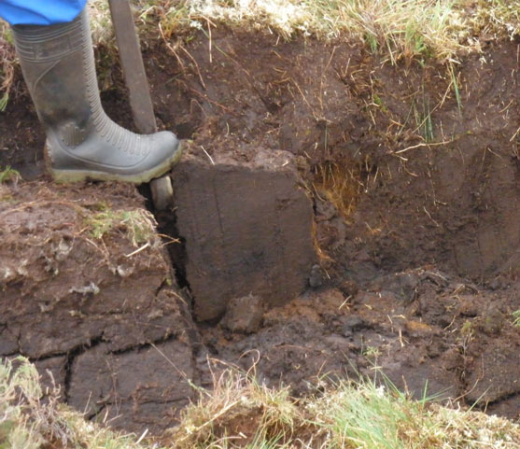
What is peat, where is peat, and how is it harvested?
Peat is an accumulation of partially decayed plant matter
Soils containing mostly peat are histosols
Found in bogs or mires
Fossil fuel due to slow regrowth
Harvested by:
Cutting
Stacking
Drying
Packing and shipping
What is Peat,where is peat and how is it harvested?

Slide 43
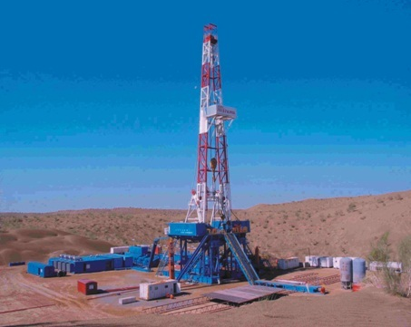
What is drilling and how is it done?
A cutting process that uses a drill bit to cut or enlarge a hole in the Earth for extraction purposes
Oil
Natural gas

Slide 44
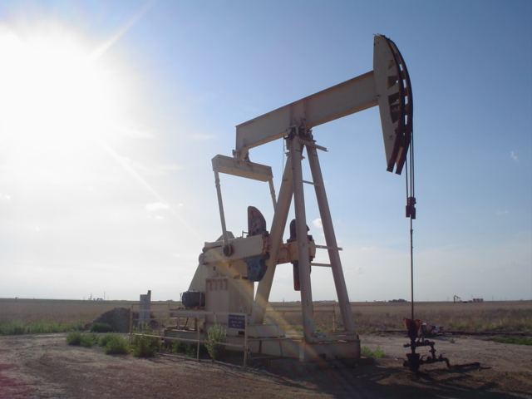
What is oil?
Formed from the remains of tiny plants
Non – renewable resource
Obtained by drilling
Found using seismology and other tools such as magnetometers and gravity meters
oil formation

Slide 45
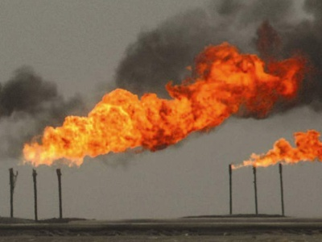
What is natural gas?
Contains mostly methane
Created in bogs deep underground
Non renewable energy source
Mostly obtained by drilling
Commonly found in coal seems, shale formations and sandstone beds

Slide 46
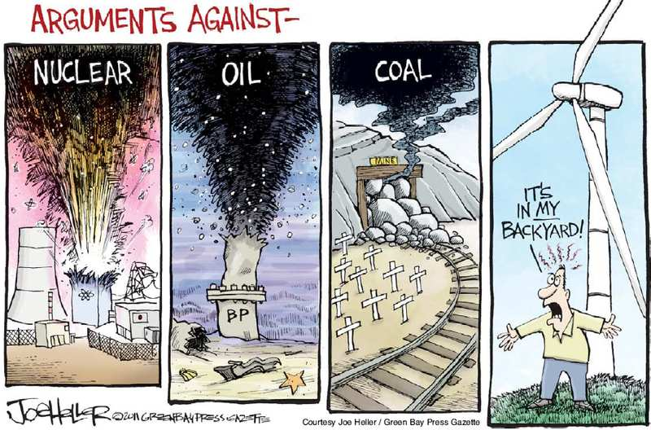

Slide 47
What can we do?
Alternative energy sources:
Solar
Wind
Hydroelectric
Wave power
Nuclear
Biofuel
Geothermal
Fuel cells

