Slide 1
HYDROSPHERE
Surface Water

Slide 2
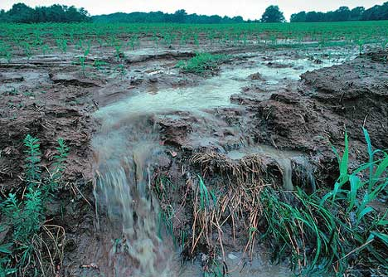
Surface Water
Runoff is excess water that does not permeate into the land and flows over the surface instead.
Runoff may reach a stream, river, or lake, may evaporate or accumulate and eventually seep into the ground.

Slide 3
Factors Affecting Runoff
Runoff
Vegetation – reduces runoff by allowing more water to enter the ground
Precipitation – light, gentle rainfall causes less runoff than a torrential downpours.
Soil Composition – high runoff if soil consist of silt, clay or shale, low runoff if soil consist of gravel or sand
Slope of the land – steep slope = high runoff, shallow slope = low runoff

Slide 4
Surface Water
Stream Systems
A stream is a channel with permanent water flow.
Tributaries are streams that flow into other streams, increasing the size of the stream it is joining.
A large stream is called a river, and all its tributaries make up a stream, or river system.
Smaller tributaries are known as creeks and brooks.

Slide 5
Surface Water
Rivers
Flow of a river or stream is due to GRAVITY.
Discharge is the speed at which a river flows (volume rate of water flow; or how much water is passing by).
The following formula is used to calculate the discharge of a stream:
discharge = width X depth X velocity (m³/s) (m) (m) (m/s)

Slide 6
Surface Water
Moving Water Carves a Path
Stream banks are the ground bordering the stream on each side
A stream channel forms as the moving water erodes a narrow pathway into rock, creating sediment.

Slide 7
Surface Water
Formation of Stream Valleys
As a young stream actively erodes its path through the sediment or rock, a V-shaped channel develops.
As the stream matures, its slope becomes more gentle, forming a U-shaped valley and flood plains in which it begins to slow down and meander.
An old stream has a gentle slope that causes extreme meandering and a wide flood plain with natural leeves
A stream erodes until its base level, the elevation at which it enters another stream or body of water.

Slide 8
Surface Water
Stream Load
A stream carries its load in 3 ways:
Solution – Soluble material which is transported in solution (ions like Ca, K, Cl, SO4, CO3) and may end up in the ocean.
Suspension – sediment light enough to stay suspended in turbulent water (silt and clay).
Bed load – sediment particles that travel on the streambed (sand and gravel).

Slide 9
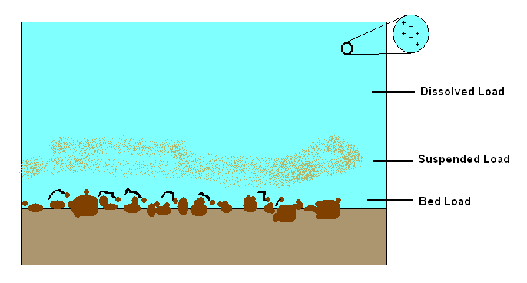

Slide 10
Surface Water
Meandering Streams
A stream’s slope, or gradient, decreases as it nears its base level.
Sometimes, the water begins to erode the sides of the channel in such a way that the overall path of the stream starts to bend or wind.
A meander is a bend or curve in a stream channel caused by moving water.

Slide 11
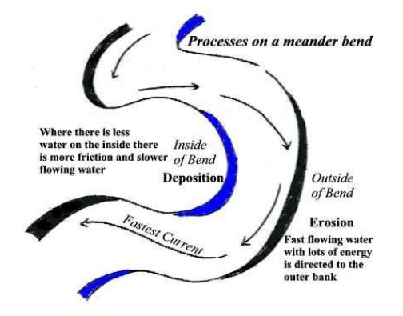
Surface Water
Meandering Streams
Outside of curve-heavy erosion occurs, water moves fastest.
Inside of curve-deposition occurs, water moves slowest

Slide 12
Surface Water
Meandering Streams cont.
It is common for a stream to cut off a meander and once again flow along a straighter path.
The cut off meander becomes an oxbow lake, which eventually dries up.
At the mouth of the stream, the gradient begins to flatten and the channel becomes wide.

Slide 13
Surface Water
Deposition of Sediments
Gradient (slope) decreases, velocity decreases.
In dry regions, a stream’s gradient may suddenly decrease causing the stream to drop its sediment at the base of a slope as a fan-shaped deposit called an alluvial fan.

Slide 14
Surface Water
Deposition of Sediments cont.
Streams lose velocity when they join larger bodies of quiet water.
A delta is the triangular deposit, usually consisting of silt and clay particles, that forms where a stream enters a large body of water.

Slide 15
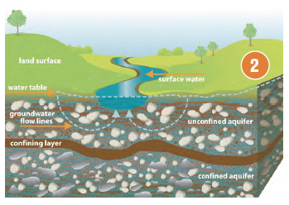
Surface Water and Ground Water
Groundwater and surface water have a reciprocal relationship, regularly feeding each other. Most streams and rivers get about half their volume from groundwater.
Notes:
Source: The Water Connection

Slide 16
North Carolina’s Estuaries and Wetlands
-An estuary is the area in which one or more rivers enter into the ocean, creating brackish water.
-A wetland is any area, for at least part of the year, in which the soil is completely saturated or covered with a shallow layer of water.
-Area surrounding estuaries is typically going to be wetland.

Slide 17
Reasons to Preserve Estuaries
Economic resource-tourism, fisheries
Biologically diverse-densely populated
Center for many species’ reproduction

Slide 18
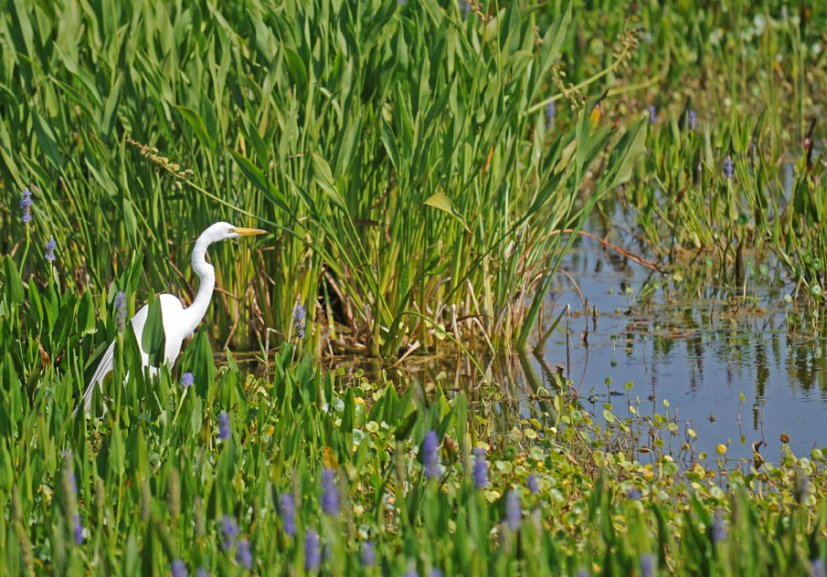
Reasons to Preserve Wetlands
Wetlands naturally filter pollutants
Can withstand excessive amounts of runoff, preventing flooding
Plants assist in stabilizing shorelines
Provide fish & wildlife habitats

Slide 19
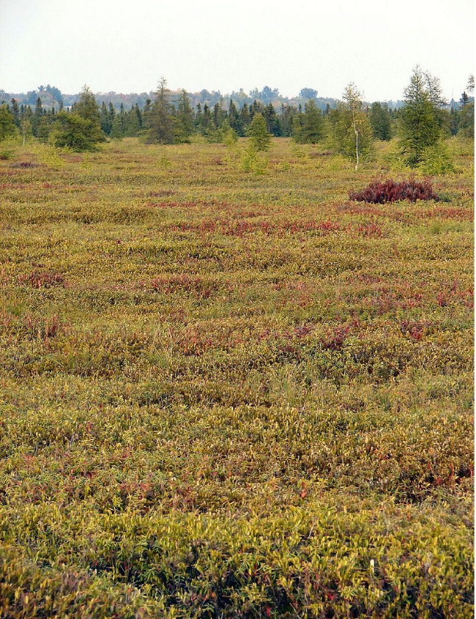
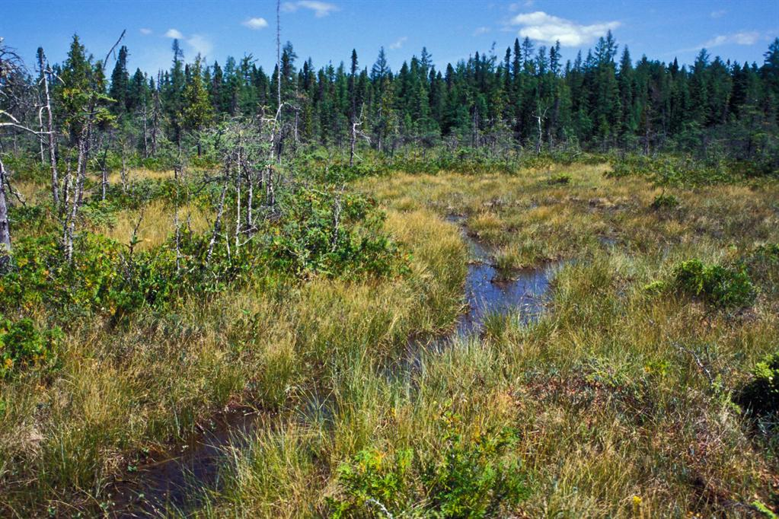
Bog vs Fen
Fens have less peat and more plant life than a bog.
Bogs are characterized by their poor soil and high peat content.

Slide 20
Swamp vs Marsh
Swamps are defined by their ability to support woody plants and trees,
Marshes are nutrient-rich wetlands that support a variety of reeds and grasses

Slide 21
Watershed/Drainage Basin
A watershed or drainage basin is the land area that contributes water to a stream.
A divide is an imaginary line that separates the drainage basins of one stream from another.

Slide 22
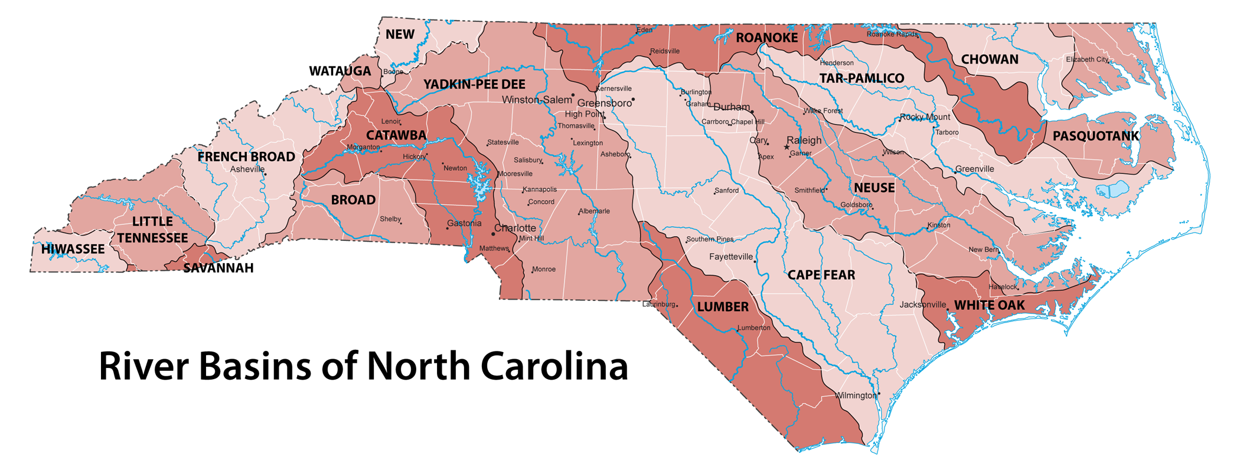
NC Drainage Basin
Raleigh

Slide 23
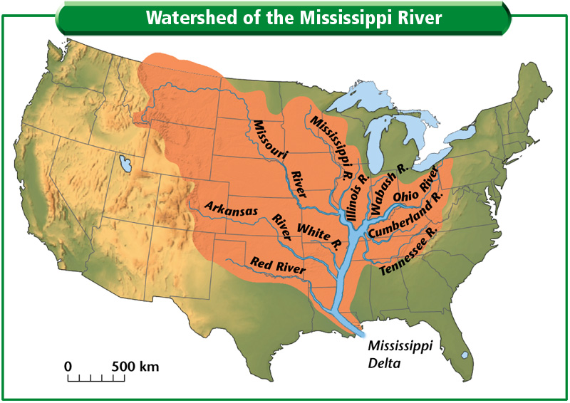
Watershed/Drainage Basin

Slide 24
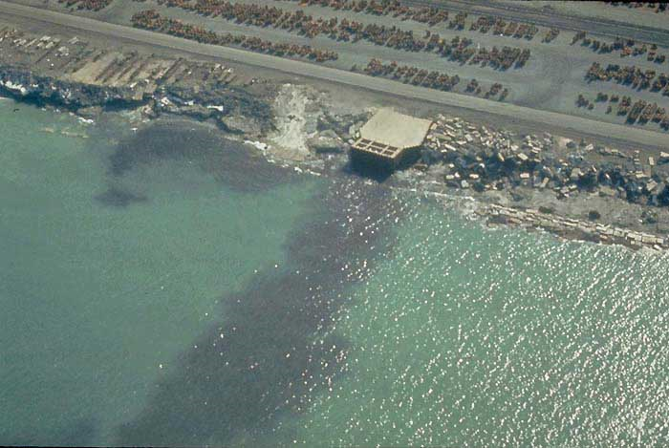
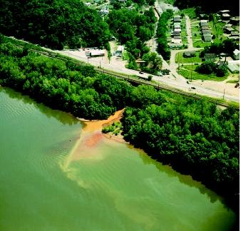
Threats to Our Water Supply
*Point Source Pollution: comes from a single, localized source
EX: factory

Slide 25
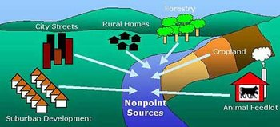
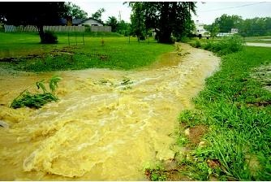
Threats to Our Water Supply
*Nonpoint source pollution - pollution from a general area
Ex: runoff from farming
area

