Slide 1
HYDROSPHERE
Water Cycle

Slide 2
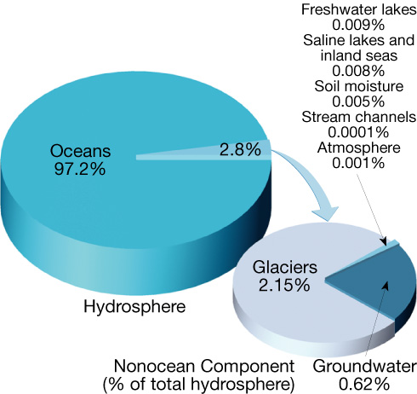
Hydrosphere
About 97 % of the hydrosphere is in the oceans.
Water contained by landmasses—nearly all of it freshwater—makes up about 3 %

Slide 3
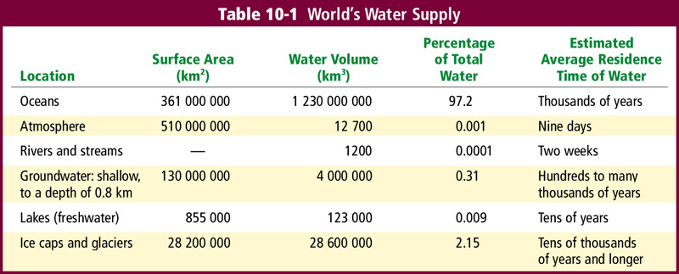
Hydrosphere

Slide 4
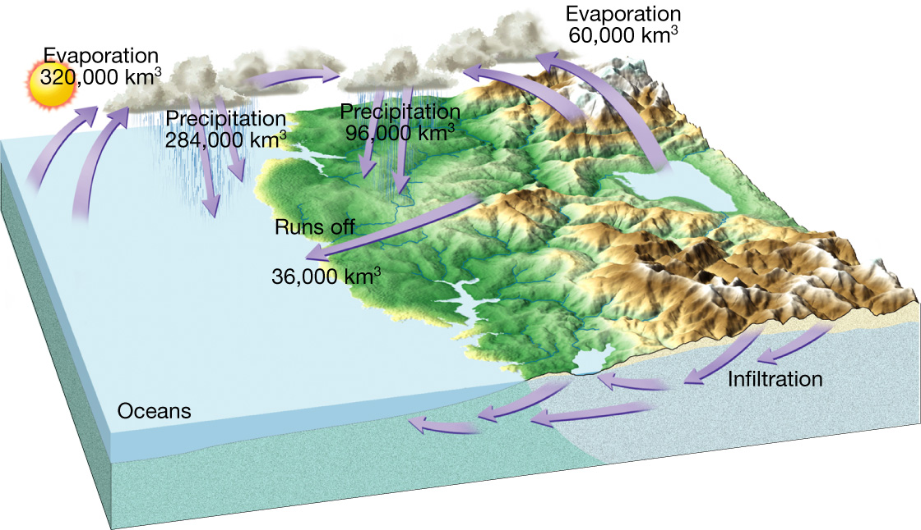
Water Cycle
Water constantly moves among the oceans, the atmosphere, the solid Earth, and the biosphere. This unending circulation of Earth’s water supply is the water cycle.

Slide 5
Water Cycle Processes
Evaporation - water from Earth is changed to gaseous state and enters the atmosphere.
Condensation - water vapor in the air turning into liquid water.
Precipitation - water falling to Earth as rain, snow, sleet, or hail.

Slide 6
Water Cycle Processes cont.
Infiltration - the movement of surface water into rock or soil through cracks and pore spaces.
Transpiration - the release of water into the atmosphere from plants through the ground.
Runoff - excess water that does not permeate into the land and flows over the surface instead.

Slide 7
Water Cycle Processes cont.
Sublimation - the conversion between the solid and the gaseous phases of matter, with no intermediate liquid stage.
Percolation - the movement of water through fractures or interstices of a rock or soil.

Slide 8
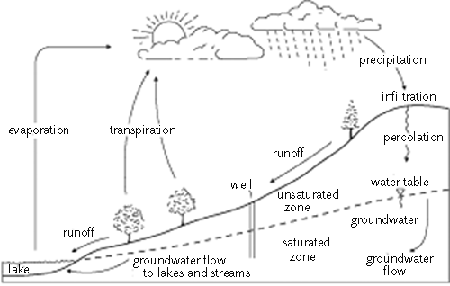
Water Cycle
solar energy source
condensation

Slide 9
Water Cycle
Balance in the water cycle means the average annual precipitation over Earth equals the amount of water that evaporates.

